Slide 1

CSE 3521: Intro to Artificial Intelligence
Instructor: Wuwei Lan
lan.105@osu.edu
The Ohio State University

Slide 2
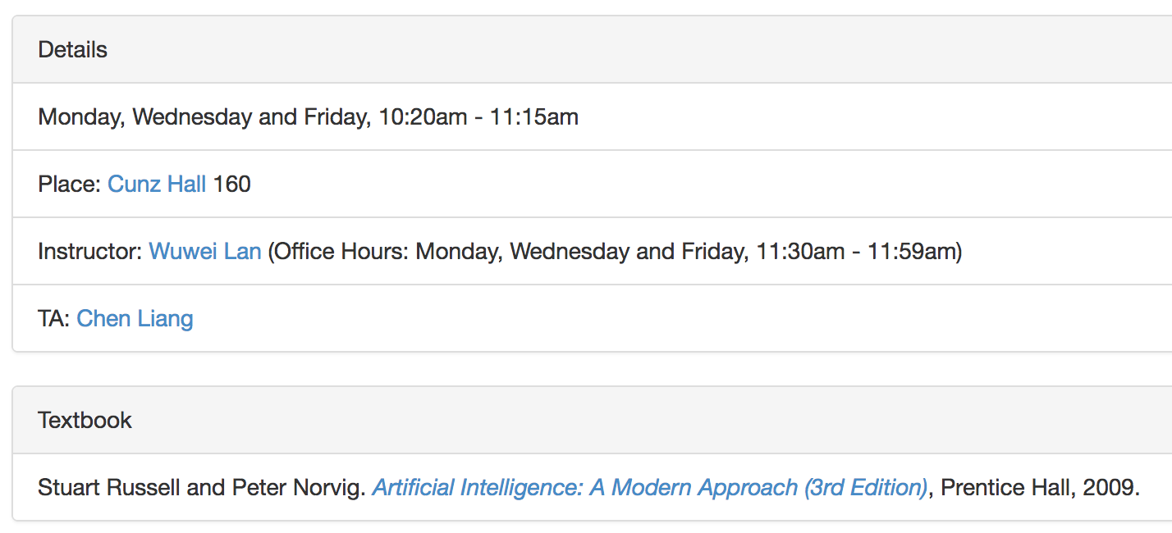
Course Information
Course website: https://lanwuwei.github.io/courses/3521_sp19
Berkeley CS 188: https://inst.eecs.berkeley.edu/~cs188/fa18/index.html

Slide 3
Homework and Grading
Expect 5-6 homework assignments over the course.
Homework submissions are individual, but feel free to discuss.
3 flexible days for project submission, but not for homework.
Grading Policy
Homework – 20%
Projects – 30%
Midterm – 20%
Final – 30%

Slide 4
Academic Misconduct
Discuss all you like, in class and out. However, all work you submit must be your own. If you cheat on a test or copy someone else’s code/solutions for homework, you will be reported to the Committee on Academic Misconduct.

Slide 5

Textbook
Not required, but if you want to read more, I recommend
Russell & Norvig, AI: A Modern Approach, 3rd Ed.
Warning: Not a course textbook, so lectures will not necessarily follow the presentation in the book.

Slide 6
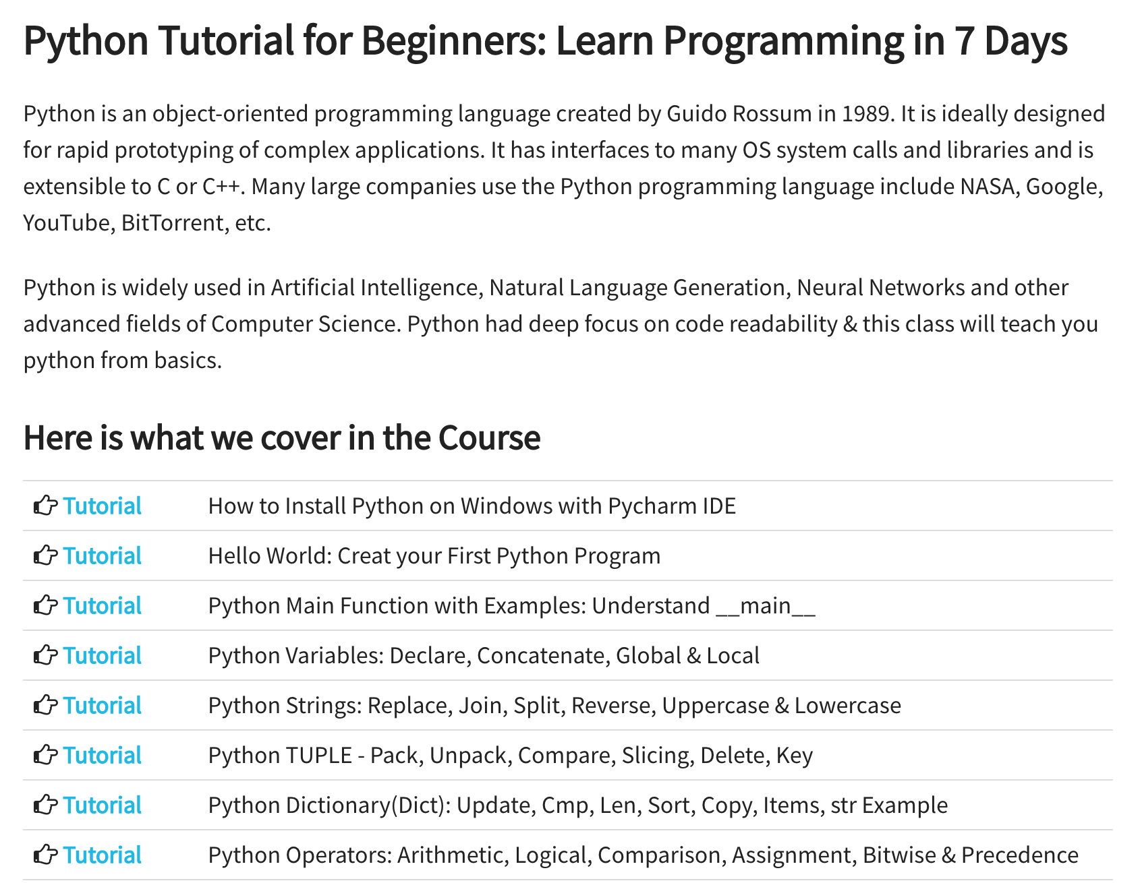
Python

Slide 7
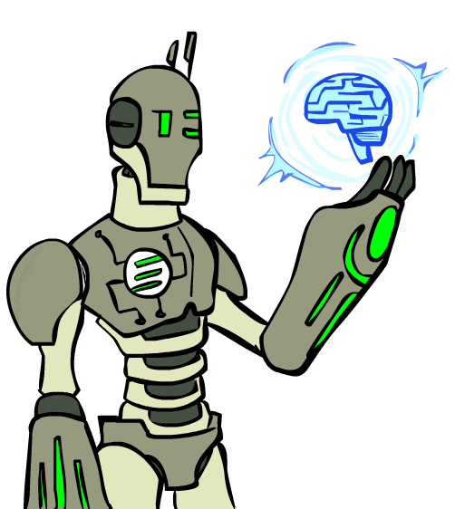
What is AI?

Slide 8
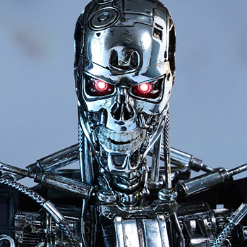
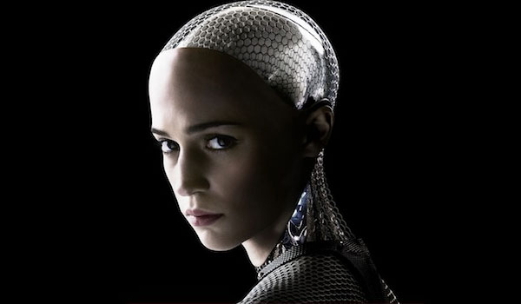
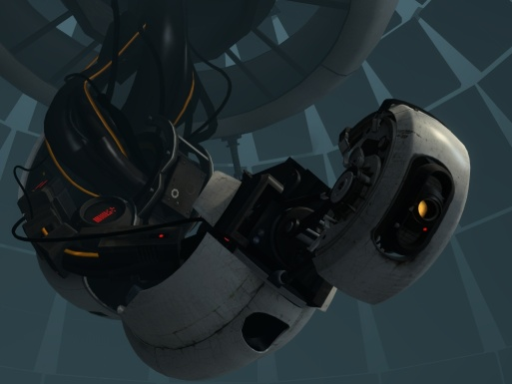
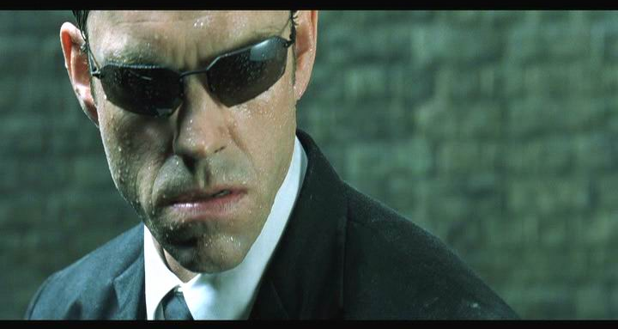
AI in Culture

Slide 9
The Turing Test
Ingredients:
Human Judge, unknown Entity
2 computer terminals in different rooms
Recipe:
Have human Judge sit at one computer
Judge converses with Entity via chat window for 5 minutes
Judge decides if Entity is human or computer

Slide 10
Which is which?
Left hand side
Judge: Hi what’s your name?
Entity: I don’t kno
Judge: My name’s Jane. I live in London. Wehre do you live
Entity: I live in london aswell
Judge: Do you like living in London?
Entity: yes I like it because there are a lot of things to do there and also it is the capital city of england
Judge: What’s my name?
Entity: sorry?
Judge: What’s my name?
Entity: jane
Judge: And what’s your name? Entity: I don’t know
Right hand side
Judge: What colour is the carpet in your room
Entity: I like pink; what do you like?
Judge: I like pink. My name is John. What’s your name? Entity: Red. Hello John. Its nice to meet such a fine person as yourself.
Judge: Red is my favourite colour. What’s yours?
Entity: My favorite color is red.
Judge: You use American spelling. Are you in the USA?
Entity: But you are not even American. Just remember atheism is only a belief system. And it too can be forced on people who don’t agree.
Judge: How do you like your eggs – ever easy or sunny side up? Entity: How I wonder if I like my eggs-over easy or sunny side up? This is so explainable. That list makes me feel unsure John.
Example taken from “Turing’s Imitation Game,” by Warwick and Shah (2016)

Slide 11
What good is passing the Turing Test?
Chatting “like a human” involves:
Generating coherent language
Responding appropriately to unexpected inputs
…

Slide 12
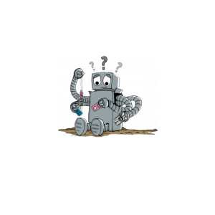
What isn’t it, though?
The Turing Test does not show
Understanding or thinking
Ability to learn
Interaction with an unconstrained world
Processing sensory input
Having knowledge
Much of anything useful, really

Slide 13
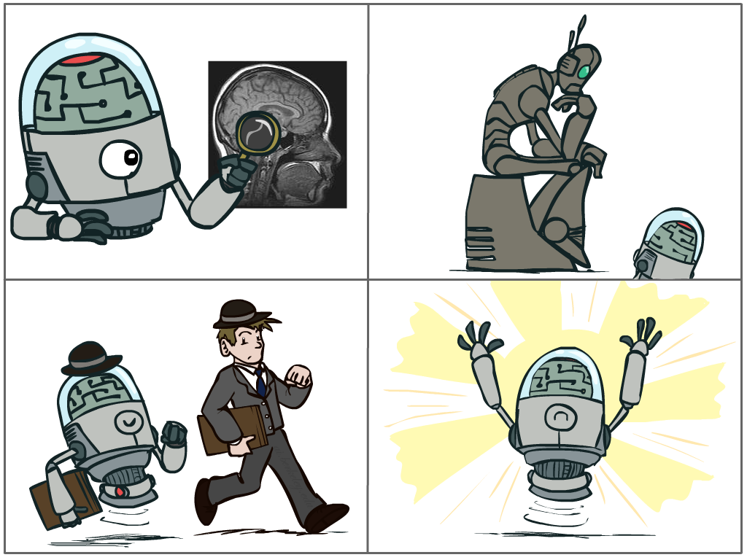
What is AI?
The science of making machines that:
Think like people
Think rationally
Act like people
Act rationally
Notes:
Top left: Think like people --- cognitive science, neuroscience
Bottom left: act like people --- actually very early definition, dating back to Alan Turing --- Turing test; problem to do really well you start focusing on things like don’t answer too quickly what the square root of 1412 is, don’t spell too well, and make sure you have a favorite movie etc. So it wasn’t really leading us to build intelligence
Think rationally – long tradition dating back to Aristotle --- but not a winner, because difficult to encode how to think, and in the end it’s not about how you think, it’s about how you end up acting

Slide 14
Rational Decisions
We’ll use the term rational in a very specific, technical way:
Rational: maximally achieving pre-defined goals
Rationality only concerns what decisions are made
(not the thought process behind them)
Goals are expressed in terms of the utility of outcomes
Being rational means maximizing your expected utility
A better title for this course would be:
Computational Rationality
Notes:
Example of utilities. 10 for A, 1 for each Friday with friends

Slide 15
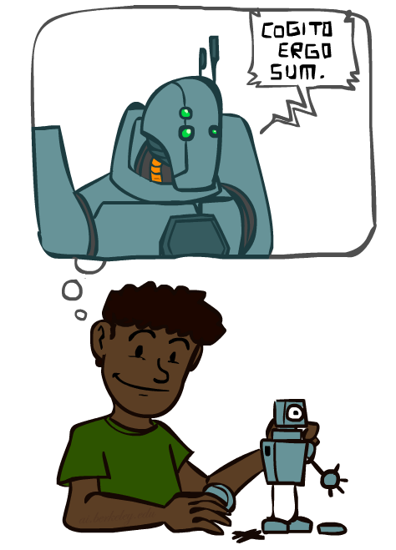
A (Short) History of AI
1940-1950: Early days
1943: McCulloch & Pitts: Boolean circuit model of brain
1950: Turing's “Computing Machinery and Intelligence”
1950—70: Excitement: Look, Ma, no hands!
1950s: Early AI programs, including Samuel's checkers program, Newell & Simon's Logic Theorist, Gelernter's Geometry Engine
1956: Dartmouth meeting: “Artificial Intelligence” adopted
1965: Robinson's complete algorithm for logical reasoning
1970—90: Knowledge-based approaches
1969—79: Early development of knowledge-based systems
1980—88: Expert systems industry booms
1988—93: Expert systems industry busts: “AI Winter”
1990—: Statistical approaches
Resurgence of probability, focus on uncertainty
General increase in technical depth
Agents and learning systems… “AI Spring”?
2000—: Where are we now?
Notes:
Million dollar computer with less computation than your phone
MT was

Slide 16
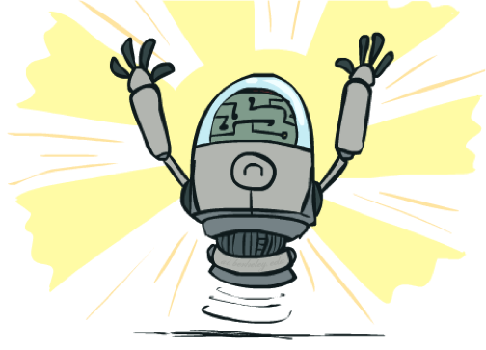
What Can AI Do?
Quiz: Which of the following can be done at present?
Play a decent game of table tennis?
Play a decent game of Jeopardy?
Drive safely along a curving mountain road?
Drive safely along High Street at rush hour?
Buy a week's worth of groceries on the web?
Discover and prove a new mathematical theorem?
Converse successfully with another person for an hour?
Perform a surgical operation?
Put away the dishes and fold the laundry?
Translate spoken Mandarin into spoken English in real time?
Write an intentionally funny story?

Slide 17
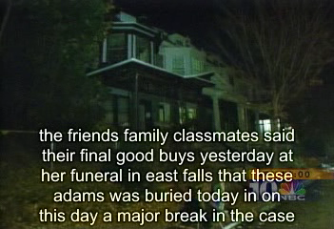
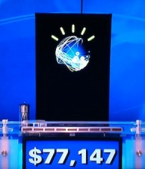
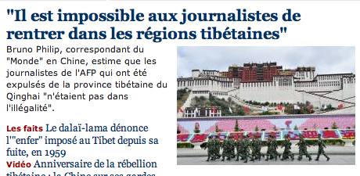
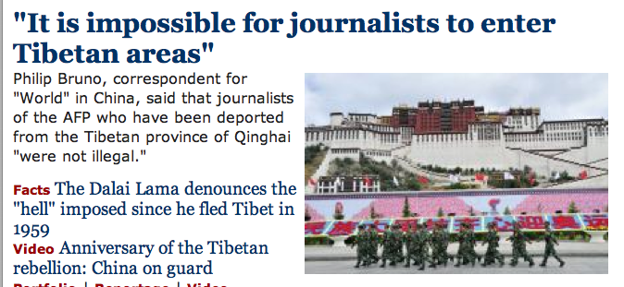
Natural Language
Speech technologies (e.g. Siri)
Automatic speech recognition (ASR)
Text-to-speech synthesis (TTS)
Dialog systems
Language processing technologies
Question answering
Machine translation
Web search
Text classification, spam filtering, etc…

Slide 18
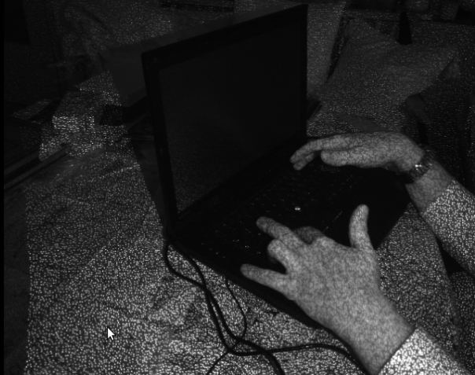
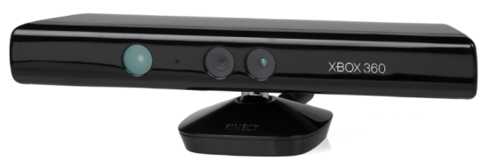
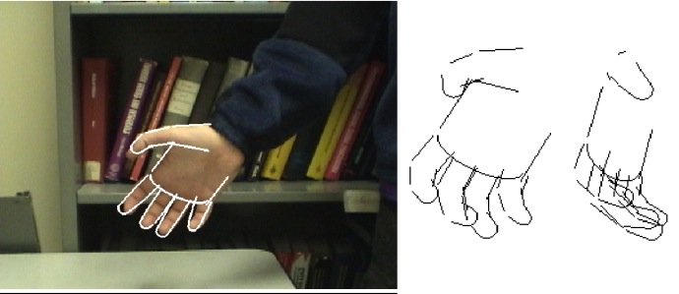
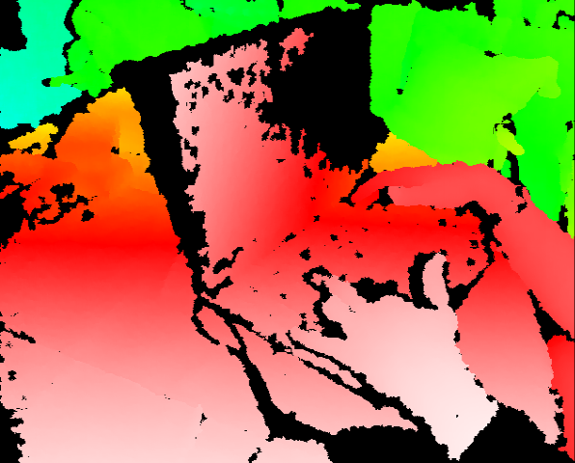
Vision (Perception)
Object and face recognition
Scene segmentation
Image classification
Demo1: VISION – lec_1_t2_video.flv
Images from Erik Sudderth (left), wikipedia (right)
Demo2: VISION – lec_1_obj_rec_0.mpg

Slide 19
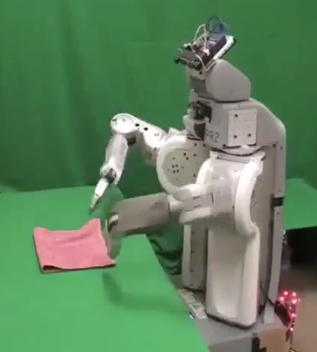
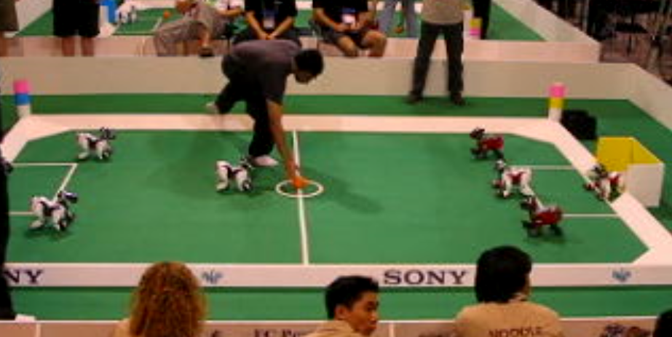
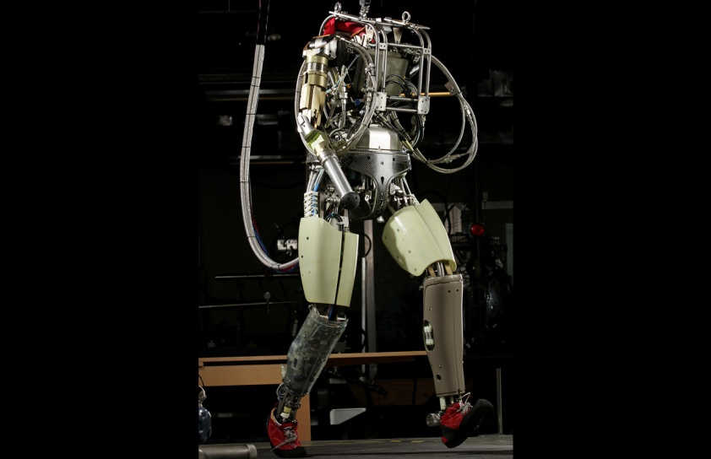
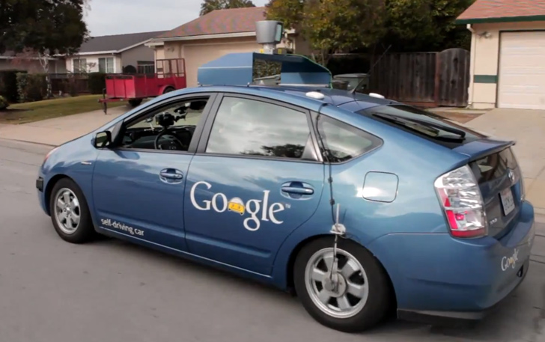
Robotics
Robotics
Part mech. eng.
Part AI
Reality much
harder than
simulations!
Technologies
Vehicles
Rescue
Soccer!
Lots of automation…
In this class:
We ignore mechanical aspects
Methods for planning
Methods for control
Images from UC Berkeley, Boston Dynamics, RoboCup, Google

Slide 20
Logic
Logical systems
Theorem provers
NASA fault diagnosis
Question answering
Methods:
Deduction systems
Constraint satisfaction
Satisfiability solvers (huge advances!)
Image from Bart Selman

Slide 21
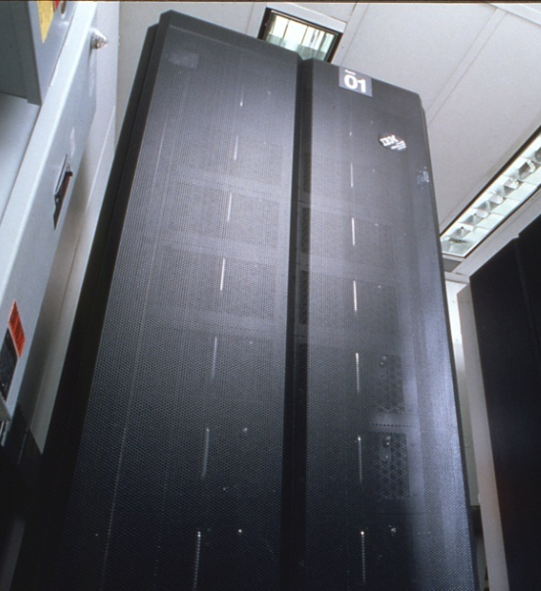
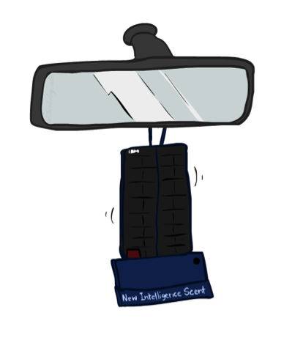
Game Playing
Classic Moment: May, '97: Deep Blue vs. Kasparov
First match won against world champion
“Intelligent creative” play
200 million board positions per second
Humans understood 99.9 of Deep Blue's moves
Can do about the same now with a PC cluster
Open question:
How does human cognition deal with the
search space explosion of chess?
Or: how can humans compete with computers at all??
1996: Kasparov Beats Deep Blue
“I could feel --- I could smell --- a new kind of intelligence across the table.”
1997: Deep Blue Beats Kasparov
“Deep Blue hasn't proven anything.”
2017: AlphaGo beats…well, everyone
Text from Bart Selman, image from IBM’s Deep Blue pages
Notes:
Yeah, Kasparov comment probably says more about humans than about computers

Slide 22


Decision Making
Applied AI involves many kinds of automation
Scheduling, e.g. airline routing, military
Route planning, e.g. Google maps
Medical diagnosis
Web search engines
Spam classifiers
Automated help desks
Fraud detection
Product recommendations
… Lots more!
Notes:
All applications can be thought of as decision making or useful sub-components of decision making

Slide 23
This Course
Search: How do I (efficiently) find a solution?
Logic and Knowledge: How do I determine what is/isn’t known?
Decision Policies: How do I choose the best next action?
Probability: How do I handle dependency and non-determinism?
Machine Learning: How do I learn from past experience?
Philosophy and Ethics: How do I determine what is intelligent? And how do I know that what I’m doing is good?

Slide 24
Next Time
Homework 0 is out now – Due 01/11
Defining rational agents
What are search problems?

